Slide 1
Yelp Dataset: NLP Classifier
Nick Campanelli

Slide 2
Goal: In part 1 to develop a classifier that takes tokenized text and predicts if the review is positive or negative. In part 2 to use sentiment analysis as an alternative to star rating.
How: Using Yelp’s massive online dataset and standard NLP libraries.
Why: To understand NLP workflow and text preprocessing. To work with simple sentiment analysis and understand its efficacy in classification.

Slide 3

Yelp provides an all purpose dataset for learning and challenges (https://www.yelp.com/dataset)
Some quick facts
6.8 million reviews for 192 thousand business in 10 metropolitan areas!
Stored in several massive JSON files!
Aggregated check in data, photos and business attributes also available!

Slide 4
Predicting Review Labels
with
4,000 restaurants and 330,000 reviews

Slide 5
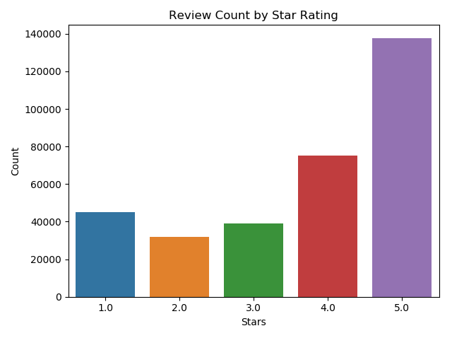

Slide 6
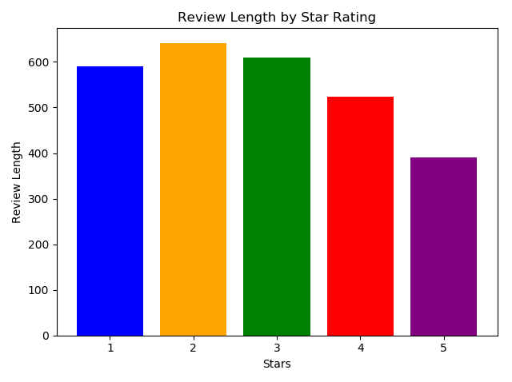

Slide 7
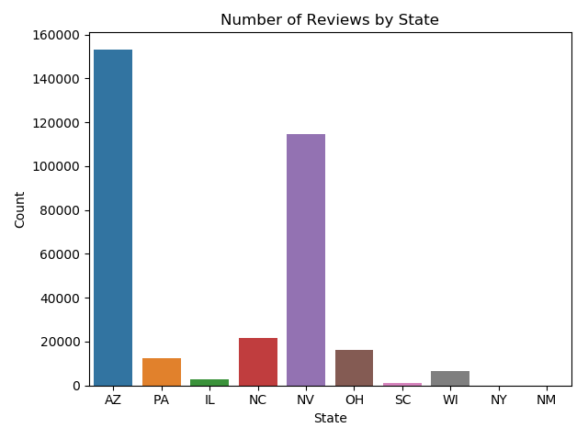

Slide 8
Cleaning and Tokenizing
In order to feed text into a classifier it first needs to be cleaned and tokenized. Using an example sentence here are the steps I took:
Ex: “This restaurant has great service, and DELICIOUS food that tastes like home!!”
Lowercase and punctuation
“this restaurant has great service and delicious food that tastes like home”

Slide 9
“this restaurant has great service and delicious food that tastes like home”
Remove stop words, turn into list of tokens
[“restaurant”, “has”, “great”, “service”, “delicious”, “food”, ”tastes”, “home”]
Count Vectorize

Slide 10
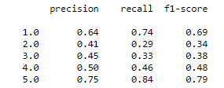
Model 1
Word tokens, CountVectorizer, Multinomial Naive Bayes, 5 targets, f1 scores!

Slide 11

Model 2
Word tokens, CountVectorizer, Multinomial Naive Bayes, 2 class targe, f1 score!

Slide 12
NGrams tokenization??
Sentence ordering information is lost with word tokenization!
N-gram tokenization (2,3,4 etc) keeps the information that comes with ordering!
Think of the difference (but, good) and (good, but)
MASSIVE VOCABULARY
Ex: “I want to eat their burritos again!”
[(I, want), (want,eat), (eat,their), (their, burritos), (burritos,again)]
Bigram tokenization

Slide 13

Model 3
Bigrams, CountVectorizer, Multinomial Naive Bayes, 2 class targe, f1 score! Vocabulary = 3.4 million bigrams

Slide 14

Feature Selection w/ Chi Squared
Chi Squared statistic compares observed vs. expected frequencies in counts to ascertain whether a given term and the change in class are independent. The bigrams with the highest chi-squared value are the most informative features!
Filtering bigrams based on a p-value <= 0.05 reduced the vocabulary by 96% - down to the 150,000 most informative features

Slide 15

Model 4 - Final Model
Bigrams, Chi-Squared feature selection, CountVectorizer, Multinomial Naive Bayes, 2 class targe, f1 score! Vocabulary = 150,000 bigrams

Slide 16
Conclusions
Relatively high f1 scores can be attained with a simple bag of words model.
Stratified sampling for 5 class prediction.
Word tokenization < n-gram tokenization. Would tri or quad be better?
Feature selection is key!
Will this work when generalized to all reviews?

